Slide 1
Probability Theory for Data Scientists
Based on PH125.3x (Probability) from Harvard edX
Christopher Rutherford

Slide 2
Overview
Discrete Probability and Probability Theory
Monte Carlo Simulations
Continuous Probability
Continuous Probability Distributions
Distributions and Probability Distributions
Expected Value and Standard Error
Application: Interest Rates and The 2007 Financial Crisis

Slide 3
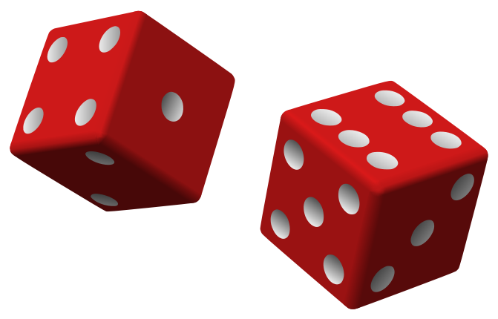
Introduction
Probability theory is very useful in helping us answer questions about the uncertainty of events
An “event” is defined as “an outcome that can occur when when something happens by chance”
Being able to quantify uncertainty gives us a better idea of how often we should expect events to occur, or not occur
Some of these events could include rolling a 3 on a die, it raining tomorrow, getting the winning lottery numbers, and just about anything else with some degree of uncertainty to it

Slide 4
Some Probability Notation
Capital letters, typically A, B, C, are shorthand for an event
P(A): the probability of event A occurring
P(A|B): the probability of event A occurring, given that event B occurred
P(A and B): the probability of both events A and B occurring
P(A or B): the probability of event A, event B, or both events occurring

Slide 5
The Mathematics Behind Discrete Probability
The probability of some event A occurring is typically written as P(A) or Pr(A)
A common example involves flipping coins: if A is flipping a fair coin and getting tails, then P(A) = 0.5 or 50%
Probabilities for simple events can typically be calculated by dividing the number of outcomes we are interested in by the total number of outcomes that can occur
For example: What is the probability of rolling an even number on a fair die?
Our outcomes of interest are the even numbers we can roll, which are the numbers 2, 4, and 6, so we have three outcomes of interest
There are six total outcomes from rolling a die
To find the probability, we divide three by six which is just 3/6=½ or 0.5

Slide 6
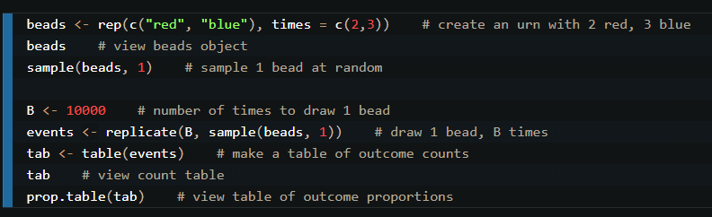
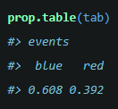
Monte Carlo Simulations
These events and outcomes can be modeled through what are known as Monte Carlo simulations
These simulations provide demonstrations of the underlying theory by performing repeated simulations
Another common probability example is an urn containing different colored beads
This block of code allows us to pretend we are drawing one bead from an urn that contains 2 red and 3 blue beads, 10,000 times
The urn contains 2 red beads and 3 blue beads
We draw one bead, record our answer, and return it
Repeat this process 10,000 times
Intuition tells us the probability of a red bead should be 0.4 and blue 0.6
This is confirmed by the output of the table

Slide 7
Independence of Events
Two events are considered independent if the outcome of one event, say A, does not affect the other event, say B
Example: let event A be rolling a three on a die, and let event B be picking a king from a standard deck of cards
Rolling a three on the die has no effect on the card being pulled
That is, event A has no effect on event B - the probability of B is unchanged whether or not event A occurs
Therefore events A and B are independent
When two events are independent, P(A and B)=P(A)*P(B)

Slide 8
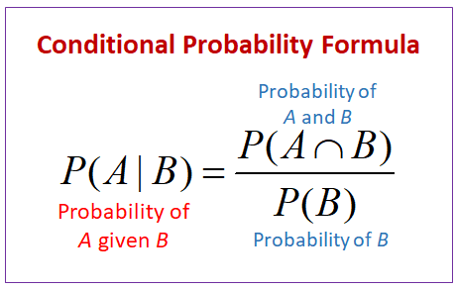
Conditional Probability
Conditional probability lets us calculate probabilities when two events are not independent (one event occurring changes the probability of the other event)
Let event A be drawing an ace on the second draw and event B be drawing a king on the first draw from a 52 card deck
We know that P(B) = 4/52 since there are 4 kings in the deck
However, we do not place this king back into the deck, so there are only 51 cards left
Thus P(A|B) (the probability of drawing an ace, given we drew a king) becomes 4/51
When two events A and B are independent, P(A|B)=P(A) since B occurring (or not) does not affect the probability of A occurring

Slide 9
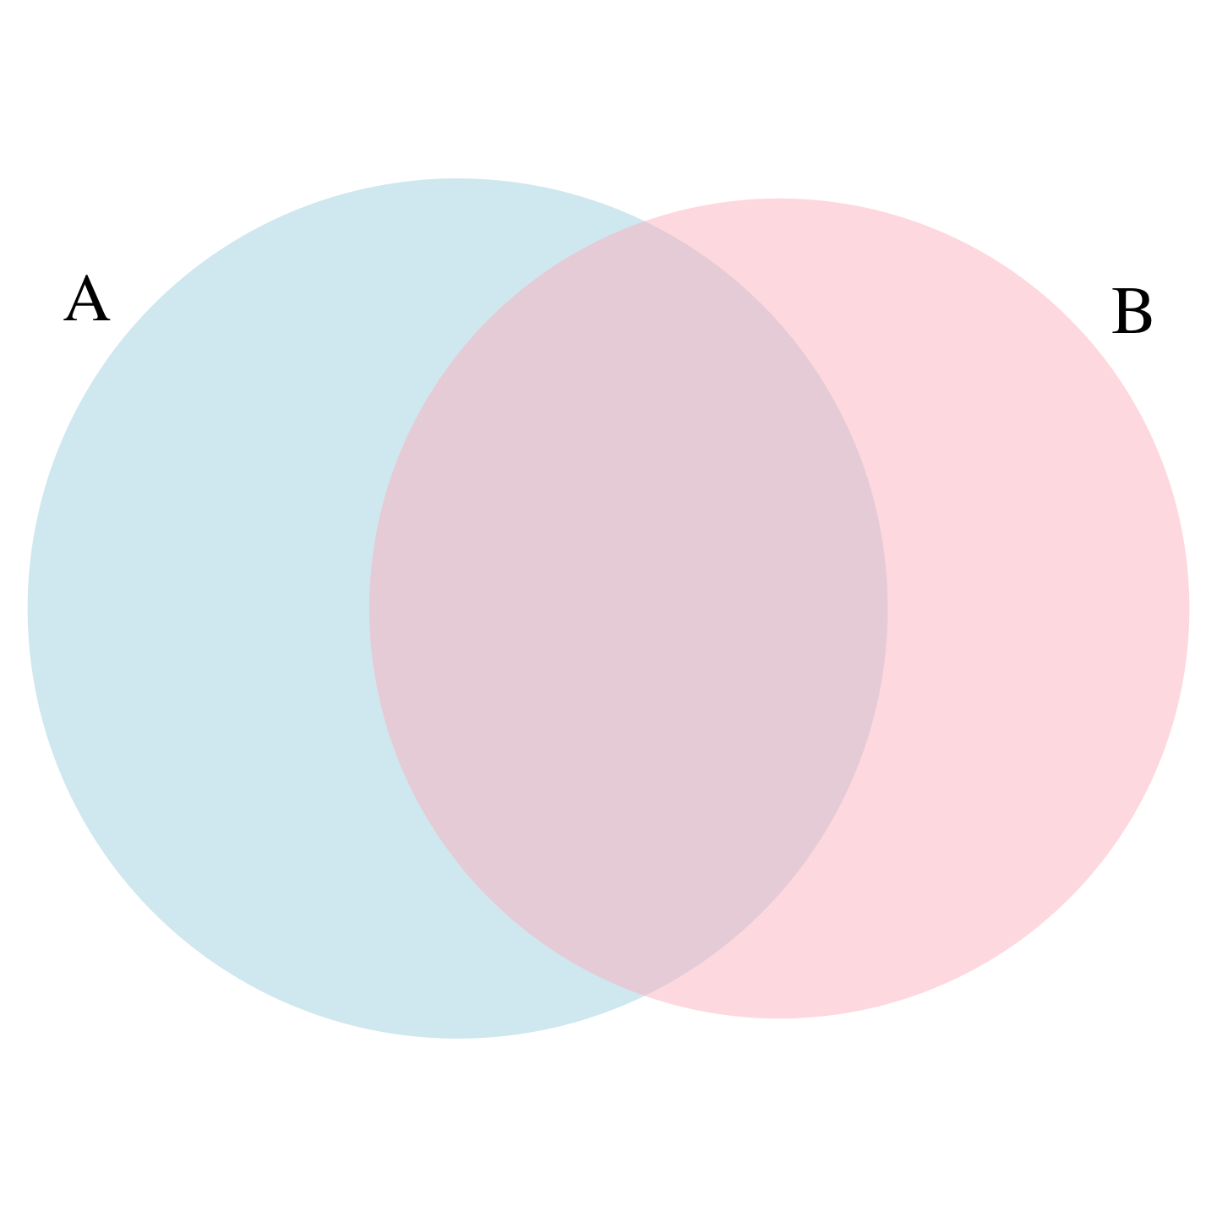
Addition and Multiplication Rules
For the probability of one of, or both, events A and B occurring, we use the addition formula: P(A or B) = P(A) + P(B) - P(A and B)
P(A and B) is subtracted because adding P(A) and P(B) causes the overlap, or intersection, to be counted twice
For the probability of both A and B occurring, we use P(A and B) = P(A)*P(B|A)
This in turn gives us a formula for computing conditional probabilities: P(B|A) = P(A and B)/P(A)
For example: what is the probability of rolling a 2, given that we rolled an even number?
Let B be the event of rolling a 2 and A be rolling an even number. P(B|A) = ⅙/½ = 2/6 = 1/3

Slide 10
Combinations and Permutations
Combinations and permutations tell us how many ways a set of n objects can be arranged in k different ways
The order in which these objects are arranged does not matter with combinations, but does matter for permutations
For instance, getting 21 in blackjack would be a combination, as the order the cards are received does not matter - getting a 5, 10, and 6 in that order is the same as getting a 6, 5, and 10 in that order
Ex: with phone numbers or passcodes, the order/position of the numbers does matter, as changing the order will result in a different number/passcode. These are permutations
1234 would not be the same as 1324 for a permutation, but would be the same for a combination

Slide 11
Continuous Probability
For data that can be measured with precision and in a large population, such as height or weight, we use continuous probability distributions
We use continuous functions that help describe how these values are distributed instead of using single values
The cumulative distribution function (CDF), typically denoted as F, tells us the proportion of a population that is equal to or less than a specified value
For example, the proportion of males under 72 inches would be F(72) which is equal to P(X≤72), where X represents the height of a male randomly chosen from the population
The probability of choosing someone who is between 70 and 78 inches tall would be F(78)-F(70)

Slide 12
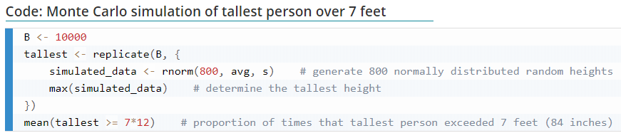
Random Variables and Sampling Models
A random variable is defined as “a numeric outcome that results from a random process” - the examples mentioned earlier, such as the number from a die roll, the card pulled from a deck, or the height of someone randomly chosen, are considered random variables
We can use Monte Carlo simulations to demonstrate how these random variables work
Set B to be equal to 10,000 - we will run 10,000 simulations
Each simulation generates 800 random normally distributed variables with the specified mean and standard deviation. Returns the highest value from these 800 variables to our variable tallest

Slide 13
Sampling Model cont.
In this example, the average and standard deviation of the heights are provided from a dataset built into R
The last line of this block of code returns how many times our sample of 800 people included someone who is 84 inches or taller
Since the data is randomly generated, the answer will change each time the simulation is run, but the answer is around 0.018

Slide 14
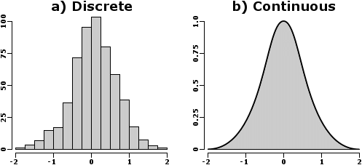

Theoretical Continuous Distributions
For continuous probability distributions, the mathematical equations can be quite complicated
R has built-in functions for calculating these probabilities very easily, such as pnorm for the normal distribution
pnorm is identical to the CDF introduced in the previous slide
For example, suppose the mean height for our group is 70 inches and the standard deviation is 2 inches
To find the probability of picking someone shorter than 71 inches, we use pnorm as follows:
pnorm(71, 70, 2)
Running this command returns 0.691 (69.1%)
1-pnorm(71, 70, 2) gives us the probability of picking someone taller than 71 inches, which returns 0.309 (30.9%)
Discrete probability distributions count frequencies; continuous probability distributions use the area under the curve between two values to find the proportion of data that lies between those two values

Slide 15


The Standard Normal Distribution
When a variable follows a normal distribution, we can convert it to a standard normal variable for simpler probability calculations
Standard normal variables have a mean of 0, standard deviation of 1, and are commonly denoted as Z
For instance, if we want the probability of choosing a person who is shorter than 70 inches, and we choose from a normal distribution with mean 67 and standard deviation 2, we can rewrite it as follows:
where, in this example, X is the random variable, m is the mean (67), s is the standard deviation (2), and a is the given value (70). We subtract the mean, then divide by the standard deviation
This is often rewritten as

Slide 16
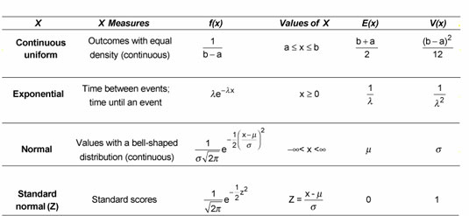
Other Continuous Distributions
The normal distribution is one of the most commonly used continuous distributions, but several others are used in practice as well, such as the exponential, gamma, uniform, and t distributions
However, for the sums and averages of variables sampled from any distribution, probabilities can be estimated and simulated using the normal distribution with the help of the central limit theorem (CLT)

Slide 17
Distribution vs. Probability Distribution: What’s the Difference?
A list of numbers follows some distribution, but this list does not have a probability distribution
A random variable X has a probability distribution, F(a), which tells us P(X<=a), which is the probability of X being less than or equal to a specified value a
Random variables are defined mathematically by their CDF, F, without using any lists of numbers
A list of numbers simulated from this random variable X, say through a Monte Carlo simulation, follows a distribution that is close to the probability distribution of X
The mean and standard deviation of this list will be close to the mean/standard deviation of X as well. The more variables generated, the better the approximation

Slide 18
The Central Limit Theorem (CLT)
The Central Limit Theorem (CLT) tells us that for large samples, the distribution for the sum and average of these samples follows an (approximately) normal distribution
“Large” is a bit subjective as larger samples are usually better, but 30 is an acceptable minimum for most samples
Distributions with extreme values, such as very small probabilities (i.e. an event with a probability of 1%), may require much larger samples to follow an approximately normal distribution
Our previous examples with simulations typically use 1,000 or 10,000 samples to guarantee that the sample sum and average follow a (nearly) normal distribution
More extreme examples, such as the probability of winning the lottery, require other distributions to accurately model

Slide 19
Expected Value and Properties
The expected value, or average, of a random value X is denoted as E[X]
E[X] is the value we expect our sample values to be near when sampling from the probability distribution that X follows
We define E[X] as the sum of each possible outcome multiplied by its corresponding probability
For instance, suppose you bet $1 on a random card drawing and only win $10 if the card is an ace
The probability of losing is 48/52 and winning is 4/52
E[X] = 48/52*(-1) + 4/52*10 = -8/52
So, if we were to simulate this bet, we would expect our average earning to be about -$8/52 per bet
The average of the sample gets closer to E[X] the larger the sample (or simulation) is
If we were to double our bet to $2, E[X] would also double to -16/52

Slide 20


Standard Error and Properties
The standard error of a random variable X is denoted as SE[X]
Standard error gives us an idea of how much the values will vary around E[X] - the larger the standard error, the more likely a value will be further away from E[X]
The standard error of the sample average is the standard deviation divided by the square root of n - this approaches zero as the sample gets larger
For a variable X that can only take two values a and b, with probabilities p and 1-p, SE[X] =
So the standard error from the previous example would be
Like the previous example, if we doubled our bet, SE[X] would also double

Slide 21
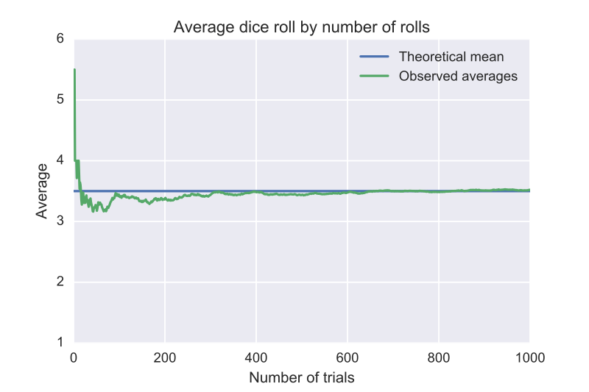
The Law of Large Numbers
The law of large numbers tells us that as an experiment is repeated, the average of the sample approaches E[X]
That is, as the sample grows larger, the sample mean approaches the true/theoretical mean
The standard error of the sample mean also gets closer to zero, so the sample mean is very close to the true mean for very large samples
The events must be independent as well - common examples include rolling a die and tossing a coin (using 0 to represent tails and 1 for heads)
The graph shows how the sample mean from rolling a die 1,000 times becomes nearly equivalent to the true mean

Slide 22
Application: Interest Rates and The 2007 Financial Crisis
We can use these tools and their properties to apply this to insurance policies and see how they affected and influenced the 2007 financial crisis
Historical default rates can be used to help banks and other financial institutions decide how much interest they should charge clients
An interest rate that is too low, or even zero, will not make up for operating costs and the losses incurred from customers who default, while a rate that is too high will attract less customers
We can mathematically model how to find the optimal interest rate to both make a profit and compete with other interest rates

Slide 23
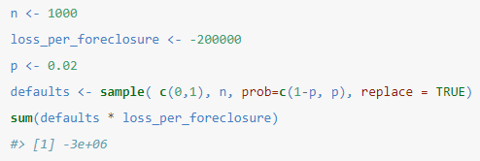
Interest Rates
There is always risk involved when banks loan money to clients, so they attach interest rates to to the loan to make up for operating costs and any potential losses incurred
Each client is assumed to have some probability, albeit very small, of defaulting on a loan
We can use Monte Carlo simulations or the CLT to help us decide on an interest rate that will minimize the impact of losses while not pushing away clients
The following code simulates how much we could lose loaning out money to 1,000 clients. Each client has a 2% chance of defaulting. A default results in a loss of $200,000
This specific simulation yielded a loss of 3,000,000, which means 15 clients (1.5%) defaulted

Slide 24
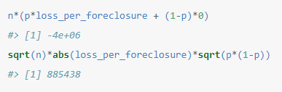

Interest Rates cont.
For 1,000 loans, E[S] and SE[S] are calculated accordingly in the code block to the right
The expected value is negative because the interest rate is 0% - there is no way to make up for money lost to people who default
To find the interest rate to break even, we use the following formula:
where l is the loss from a default, p is the probability of defaulting, and x is the desired interest rate. Solving for x yields 2.3%
This leads into our next question: What should our interest rate be to actually make money?
The above block of code calculates the expected value and standard error of S for 1,000 loans

Slide 25


Interest Rates cont.
Our goal is to minimize the probability of losing money
Suppose we want only a 1% chance of losing money
Mathematically, letting S be the sum money earned, we want P(S<0) to be 1% (or less)
Since S is approximately normal by the CLT, our calculations and simulations will be much easier to perform
We can use the expected value and standard error of this sum to help us with said calculations
As calculated in the previous slide, we have the following values for E[S] and SD[S] (this time, for any amount of clients n)

Slide 26



Interest Rates cont.
Now that we have the mean and standard error, we can do a bit of algebra and calculate the probability
As mentioned previously, we can convert any normally distributed variable to a standard normal variable. We will do this to simplify our calculation of P(S<0), which becomes
The left hand side is now a standard normal variable, so now we plug in our values of E[S] and SE[S] on the right hand side
To recap:

Slide 27
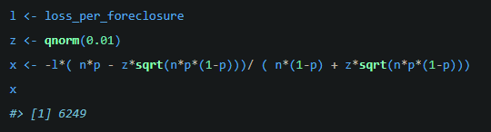
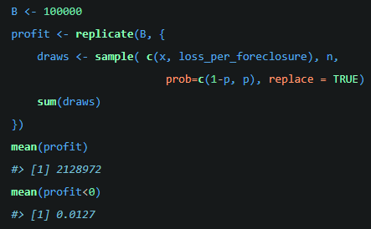
Interest Rates cont.
Complicated math aside, solving for x gives us x=6249, which is an interest rate of 3.5%
We now expect a profit of $2,124 per loan, or, using the previous example, $2,124,198 for 1,000 loans
A Monte Carlo simulation is run using these values to verify these claims:
On average, we earned $2,128,972
We lost money in 1.27% of the simulations

Slide 28
Tying it all together: The 2007 Financial Crisis
So, what’s all of this got to do with the 2007 financial crisis?
An important property of standard error come into play
This property only holds if each X in the sample is independent. However, this was not the case for loans - the probability of defaulting varied slightly per client
If something happens that affects a large group of people’s probability of defaulting, the draws are no longer independent. As such, the above properties no longer hold. We end up with the following property:
Notice that no matter what the sample size, n, is, the standard error does not change

Slide 29
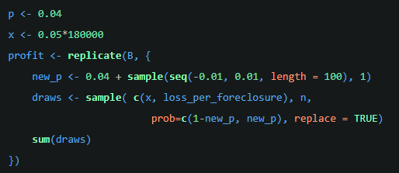
Simulating the Flaw
We can run a Monte Carlo simulation to demonstrate how much this fatal error can affect the company’s earnings and risk of losing money
The initial probability of defaulting is 4%, the interest rate is 5%
Each simulation randomly changes the probability of defaulting, setting it to be a random value between 3% and 5%
Each sample draws 1,000 people with this new, adjusted probability, and counts how much money was earned/lost
Repeat 2 and 3 10,000 times

Slide 30



So, what happened?
The results of the slight modification to the original simulation are quite startling
We still manage to have a large expected value of over $14 million:
Unfortunately, the lack of independence means our standard error stays the same, no matter the sample size. Our probability of losing money has drastically increased:
And our probability of losing $10 million (!!!) is very high as well:
This all goes to show how careful one must be when mathematically modeling real world situations, particularly in the realm of finance

Slide 31
Summary
Both discrete and continuous probability have their uses in modeling everyday events we may overlook as having some sort of probability
Monte Carlo simulations are an excellent way of assessing how these events would likely unfold in the real world. In mere minutes, we can simulate thousands of events that may take months or years to occur in real-time
Independence is an extremely useful property of random variables, but careful consideration must be taken into to ensure that independence actually holds
These tools are very powerful, but a thorough understanding of both the mathematical theory and financial domain knowledge are equally important for employing these tools effectively and properly

Slide 32
Sources and further reading
Primary Sources
https://courses.edx.org/courses/course-v1:HarvardX+PH125.3x+2T2020/course/
https://rafalab.github.io/dsbook/
Further reading
https://www.onlinemathlearning.com/conditional-probability.html
https://medium.com/analytics-vidhya/probability-distributions-444e7babf2e1
https://www.investopedia.com/terms/m/montecarlosimulation.asp
https://www.investopedia.com/terms/l/lawoflargenumbers.asp
https://betanalpha.github.io/assets/case_studies/probability_theory.html
https://statisticsbyjim.com/fun/monty-hall-problem/

